Slide 1
PERSONAL TRAINER MENTORING PROGRAME
CENTRAL YMCA CLUB

Slide 2
BE MORE THAN A PT
You can have the best knowledge or be the best fitness trainer, but if you can’t package that knowledge and turn it into a product, or don’t know how to deliver that knowledge to your clients, then your business will always struggle. The biggest problem in business is obscurity. You can be the best in the world but if no one knows who you are, no one will buy from you and you’ll go nowhere. Through our Personal Trainer Mentoring Program, we’ll teach you how to package, deliver your products, and how to market yourself so you can stand out in the crowd and reach your ideal audience. We’ll work with you to create a better version of you by setting step-by-step plan. We’ll give you a chance to get skills, knowledge and confidence to help you reach your goals, so you can make the jump from regular PT and become a champion in your range.

Slide 3
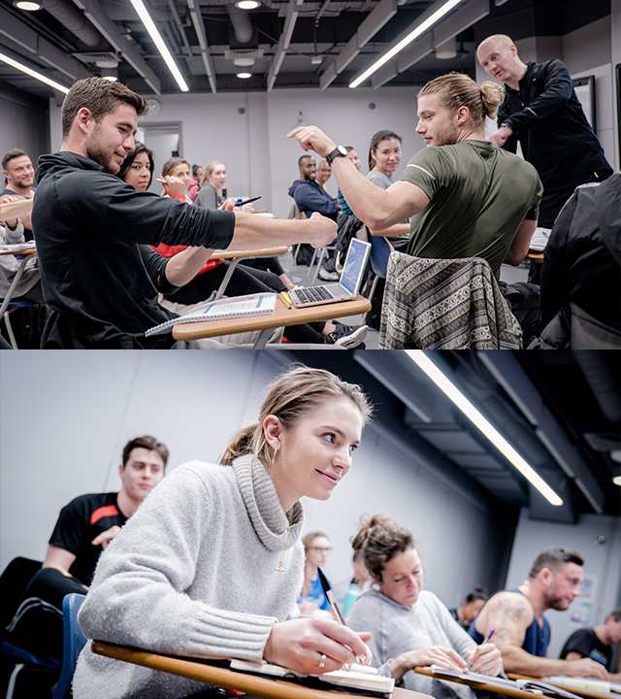
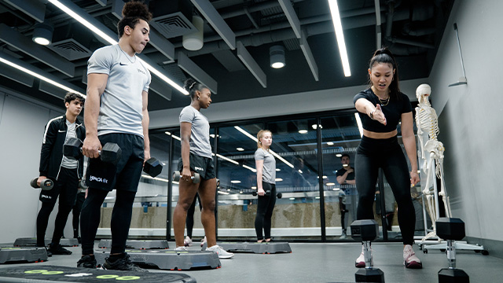
WHY TO BECOME A MENTEE
Gain practical advice, encouragement and support.
Learn from other experiences.
Increase your social confidence.
Become more empowered to make decisions.
Develop your communication and personal skills.
Develop strategies and skills for dealing with unexpected problems.
Learn how to identify goals and establish a sense of direction.
Gain valuable insight into the next stage of your career.
Make new contacts across fitness industry.

Slide 4
4 WEEK MENTROING PROGRAMME BREAKDOWN

Slide 5
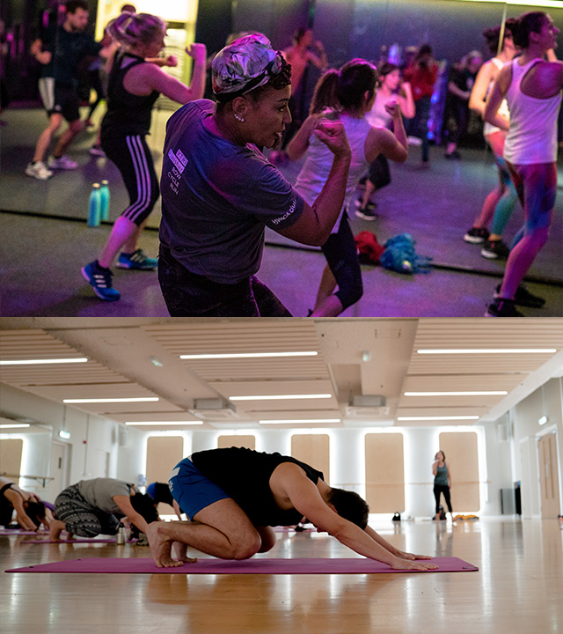
WEEK 1 (4HRS)
Shadow & learn parts of health assessment and gym sessions.
Practical training on running & supervising gym.
Building a customer interaction skills – promoting your business.
GEX importance in growing PT business. Class shadowing.

Slide 6
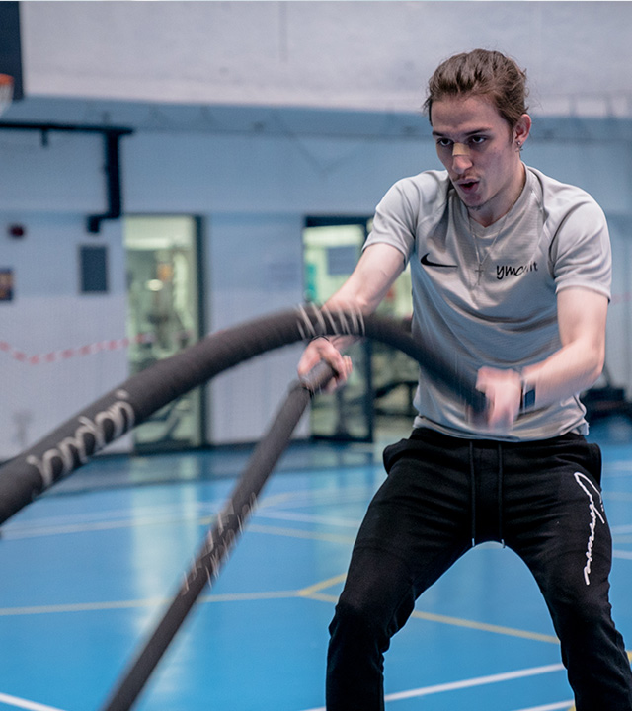
WEEK 2 (4HRS)
Shadow & plan parts of health assessment and gym sessions.
Practical training on running & supervising gym.
Building a customer interaction skills – promoting your business.
GEX importance in growing PT business. Class planning.

Slide 7
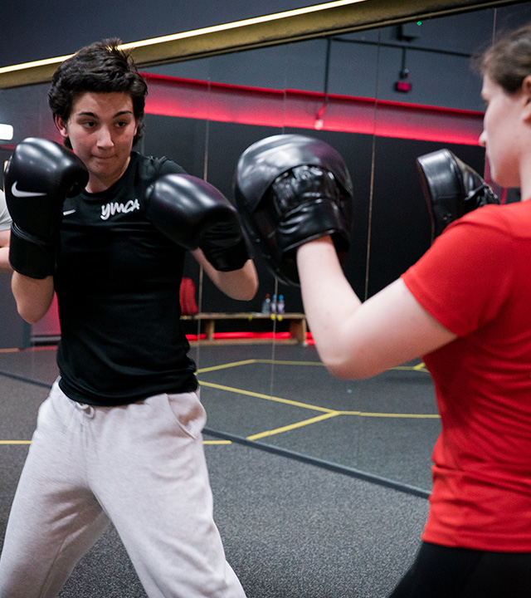
WEEK 3 (4HRS)
Plan & deliver of health assessment or gym sessions.
Practical training on running & supervising gym.
Building a customer interaction skills – promoting your business.
GEX class plan practical presentation.

Slide 8
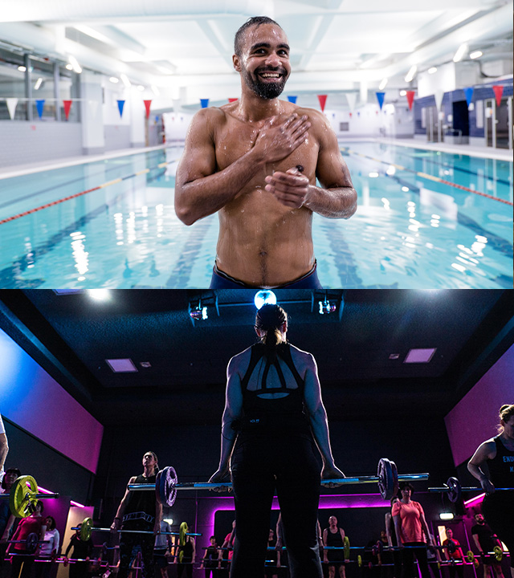
WEEK 4 (4HRS)
Plan & deliver of health assessment and gym sessions.
Practical training on running & supervising gym.
Building a customer interaction skills – promoting your business.
GEX class delivery on main timetable. (10 participants minimum)

Slide 9
To become a mentee contact
Email: Edgaras.Lindinas@ymca.co.uk

